Slide 1


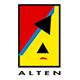

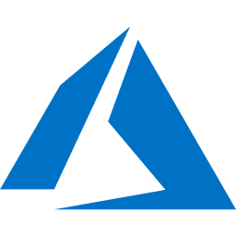
What's new in Azure App Service for DevOps
Riccardo Cappello
Operative Manager @ ALTEN Italia
Microsoft Azure MVP | Intel Software Innovator

Slide 2
#CodeGen
#dotnetconf

Slide 3
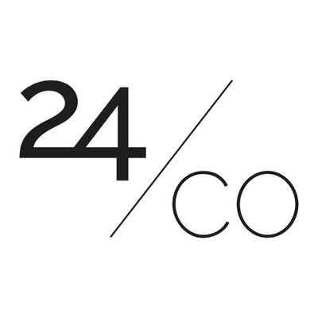
Main sponsor

Slide 4
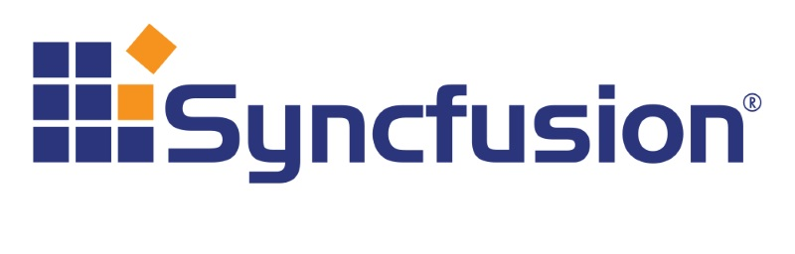
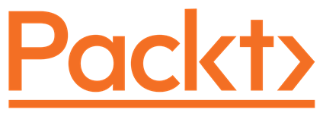
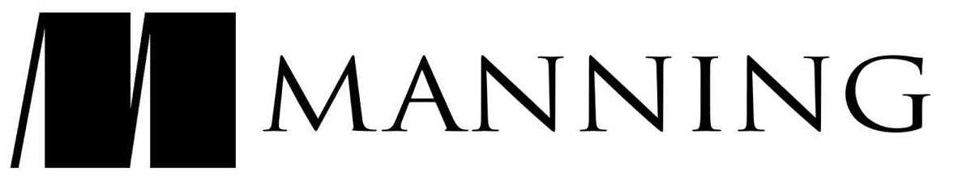
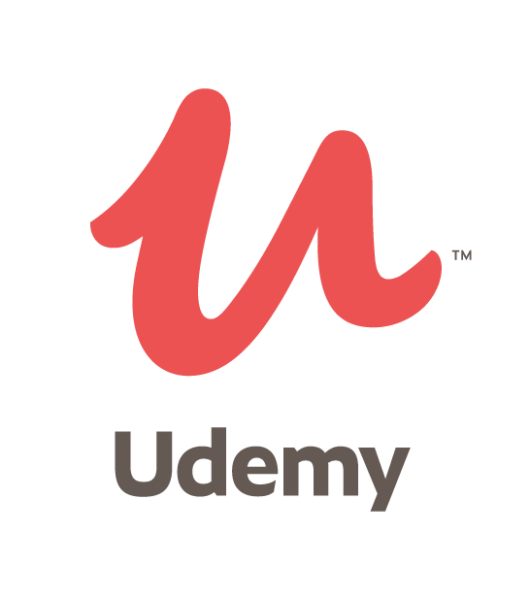


Community sponsors

Slide 5
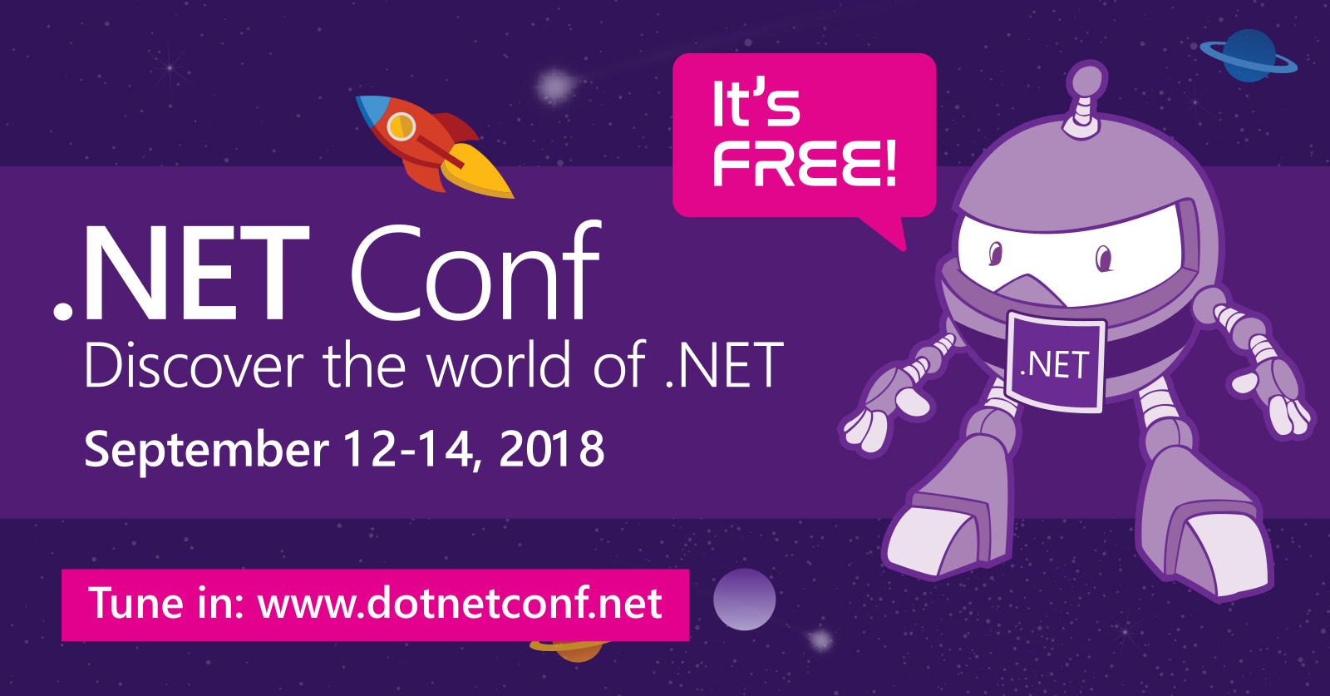
Local Event

Slide 6

@rcappello
rcappello
Riccardo CAPPELLO
Riccardo Cappello

Slide 7
Welcome Azure DevOps!
What's new in Azure App Service for DevOps
Riccardo Cappello
Operative Manager @ ALTEN Italia
Microsoft Azure MVP | Intel Software Innovator

Slide 8
What is DevOps?
People. Process. Products.
Build& Test
Deploy
DevOps is the union of people, process, and products to enable continuous delivery of value to your end users.
“
Continuous Delivery
Develop
Operate
”
Plan & Track
Monitor & Learn
Notes:
DevOps is the union of people, process and products to enable the continuous delivery of value to your end customers

Slide 9


High Performance DevOps Companies Achieve…
46x Deployment
Frequency
2,555x Faster Lead
Time For Changes
Faster
Time to Market
DevOps
$
Increased
Revenue
7x Lower Change
Failure Rate
2,604x Faster Mean
Time to Recover
Source: 2018 Accelerate: State of DevOps: Strategies for a New Economy." N. Forsgren, J. Humble, G. Kim. DevOps Research and Assessment (DORA)

Slide 10
What core technologies do I need to deploy & learn faster?
DevOps brings together people, processes, and technology, automating software delivery to provide continuous value to your users. Using Azure DevOps, you can deliver software faster and more reliably - no matter how big your IT department or what tools you’re using.
Continuous Integration (CI)
Continuous Deployment (CD)
Continuous Learning & Monitoring

Slide 11





Introducing Azure DevOps
Azure Boards
Azure Pipelines
Azure Repos
Deliver value to your users faster using proven agile tools to plan, track, and discuss work across your teams.
Build, test, and deploy with CI/CD that works with any language, platform, and cloud. Connect to GitHub or any other Git provider and deploy continuously.
Get unlimited, cloud-hosted private Git repos and collaborate to build better code with pull requests and advanced file management.
Azure Test Plans
Azure Artifacts
➔
Test and ship with confidence using manual and exploratory testing tools.
Create, host, and share packages with your team, and add artifacts to your CI/CD pipelines with a single click.
https://azure.com/devops
Notes:
So does TFS

Slide 12

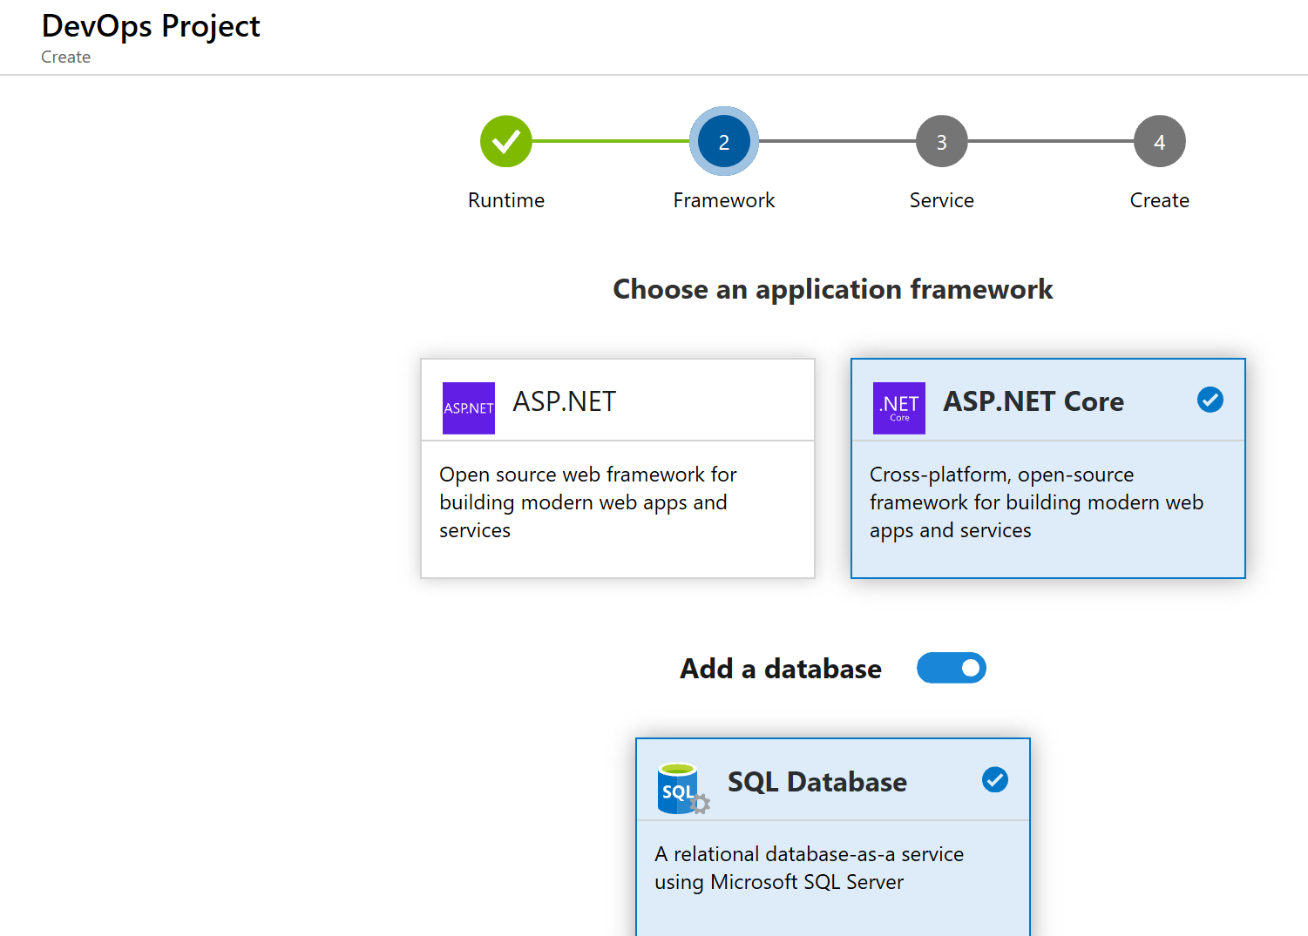
DevOps Pipelines in Minutes
Azure DevOps Projects
Create a full ASP.NET DevOps pipeline with 4 easy steps from the Azure Portal
Start with a Git repo, web app and pre-configured pipeline
Customize, extend and scale when needed.
Notes:
Moving from the developer environment, Azure also makes deploying, or integrating existing, DevOps pipelines as fast as possible
Azure DevOps Projects is the quickest way to get started with DevOps on Azure for people who know about DevOps but are just starting or want a quick way to create a basic pipeline to play with or build upon.
DevOps projects creates a basic, complete CI/CD pipeline in Azure which can later be extended and customized outside in Azure Pipelines
Although DevOps Projects builds a DevOps pipeline on Azure it allows for any easy “Getting started” experience with Azure Pipelines which can then be applied to hybrid and on-prem scenarios with Azure Pipelines which can target any platform or with Azure DevOps Server which can be installed on prem.

Slide 13
Azure DevOps Projects

Slide 14
Iteratively Removing Impediments
Build& Test
Deploy
Find the pain points in your DevOps processes and improve a bit, reassess and improve again.
Lots of small incremental improvements add up.
Continuous Delivery
Develop
Operate
Plan & Track
Monitor & Learn
Notes:
DevOps is the union of people, process and products to enable the continuous delivery of value to your end customers

Slide 15
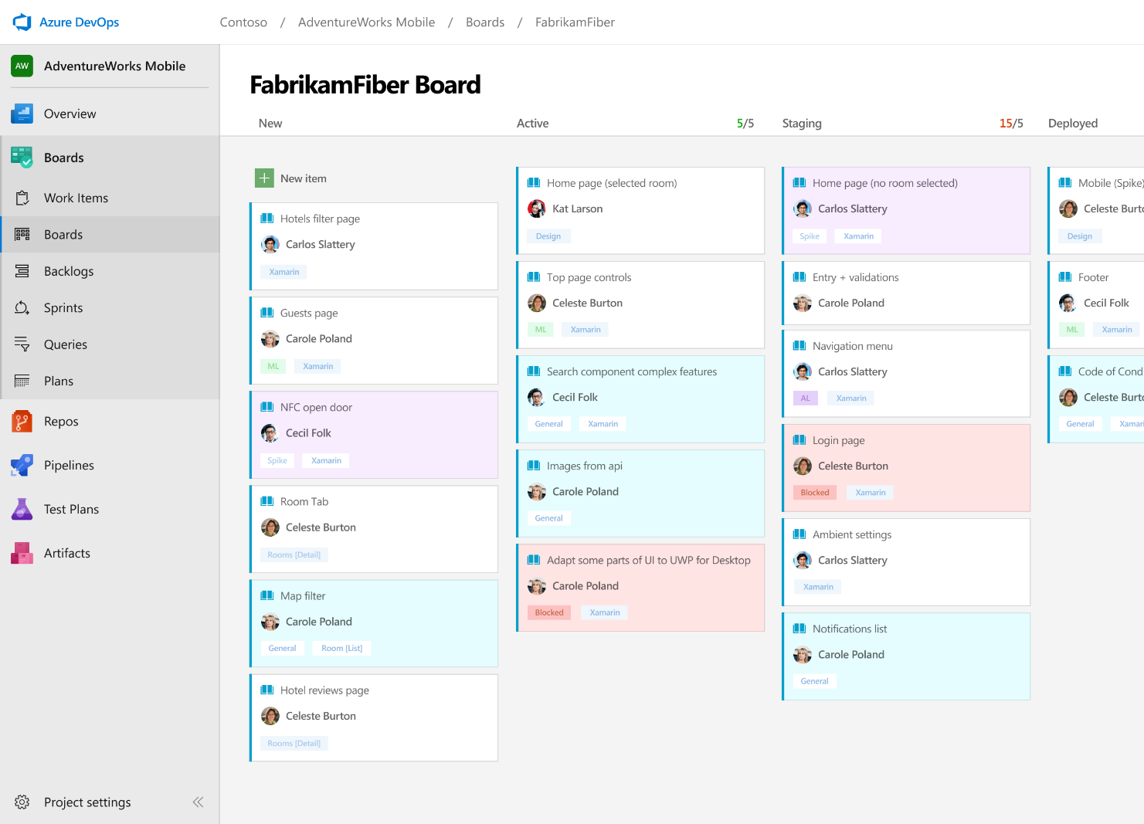



Azure Boards
Track work with Kanban boards, backlogs, team dashboards, and custom reporting
Connected from idea to release
Track all your ideas at every development stage and keep your team aligned with all code changes linked directly to work items.
Scrum ready
Use built-in scrum boards and planning tools to help your teams run sprints, stand-ups, and planning meetings.
Project insights
Gain new insights into the health and status of your project with powerful analytics tools and dashboard widgets.
➔
https://azure.com/devops
Notes:
Combine Kanban boards and drag-and-drop sprint planning with comprehensive traceability and reporting for the perfect home for all your ideas–big and small.

Slide 16
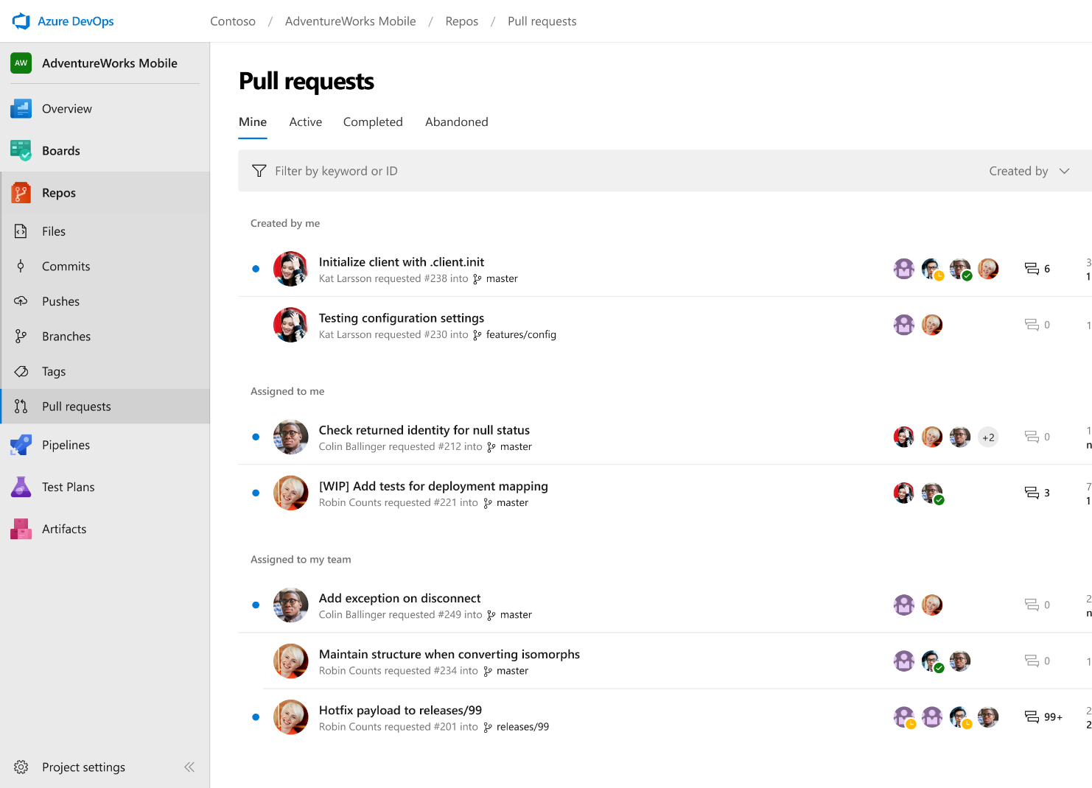



Azure Repos
Unlimited private Git repo hosting and support for TFVC that scales from a hobby project to the world’s largest Git repositories
Works with your Git client
Securely connect with and push code into your Git repos from any IDE, editor, or Git client.
Web hooks and API integration
Add validations and extensions from the marketplace or build your own using web hooks and REST APIs.
Semantic code search
Quickly find what you’re looking for with code-aware search that understands classes and variables.
➔
https://azure.com/devops
Notes:
Collaborate on code changes with threaded discussion and continuous integration for each change. Use forks to promote collaboration with Inner Source workflows.

Slide 17

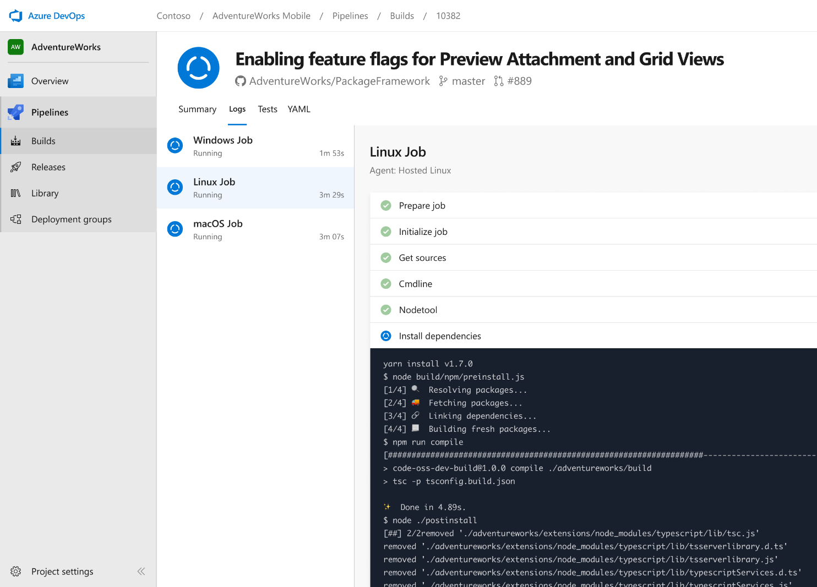


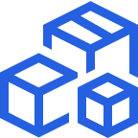

Azure Pipelines
Cloud-hosted pipelines for Linux, Windows and macOS, with unlimited minutes for open source
Any language, any platform, any cloud
Build, test, and deploy Node.js, Python, Java, PHP, Ruby, C/C++, .NET, Android, and iOS apps. Run in parallel on Linux, macOS, and Windows. Deploy to Azure, AWS, GCP or on-premises
Extensible
Explore and implement a wide range of community-built build, test, and deployment tasks, along with hundreds of extensions from Slack to SonarCloud. Support for YAML, reporting and more
Containers and Kubernetes
Easily build and push images to container registries like Docker Hub and Azure Container Registry. Deploy containers to individual hosts or Kubernetes.
Best-in-class for open source
Ensure fast continuous integration/continuous delivery (CI/CD) pipelines for every open source project. Get unlimited build minutes for all open source projects with up to 10 free parallel jobs across Linux, macOS and Windows
➔
https://azure.com/pipelines
Notes:
Azure Pipelines is the perfect launchpad for your code – automating your builds and deployments so you spend less time with the nuts and bolts and more time being creative

Slide 18


Azure Pipelines
Microsoft Open Source
Free unlimited build minutes for public projects
Up to 10 free parallel jobs across Windows, Linux and macOS
➔
https://azure.com/pipelines
Notes:
All the builds you need, using the power of Azure you get one service that gives you unlimited build minutes where you can build on Windows Mac and Linux in parallel using a single build YAML file.

Slide 19

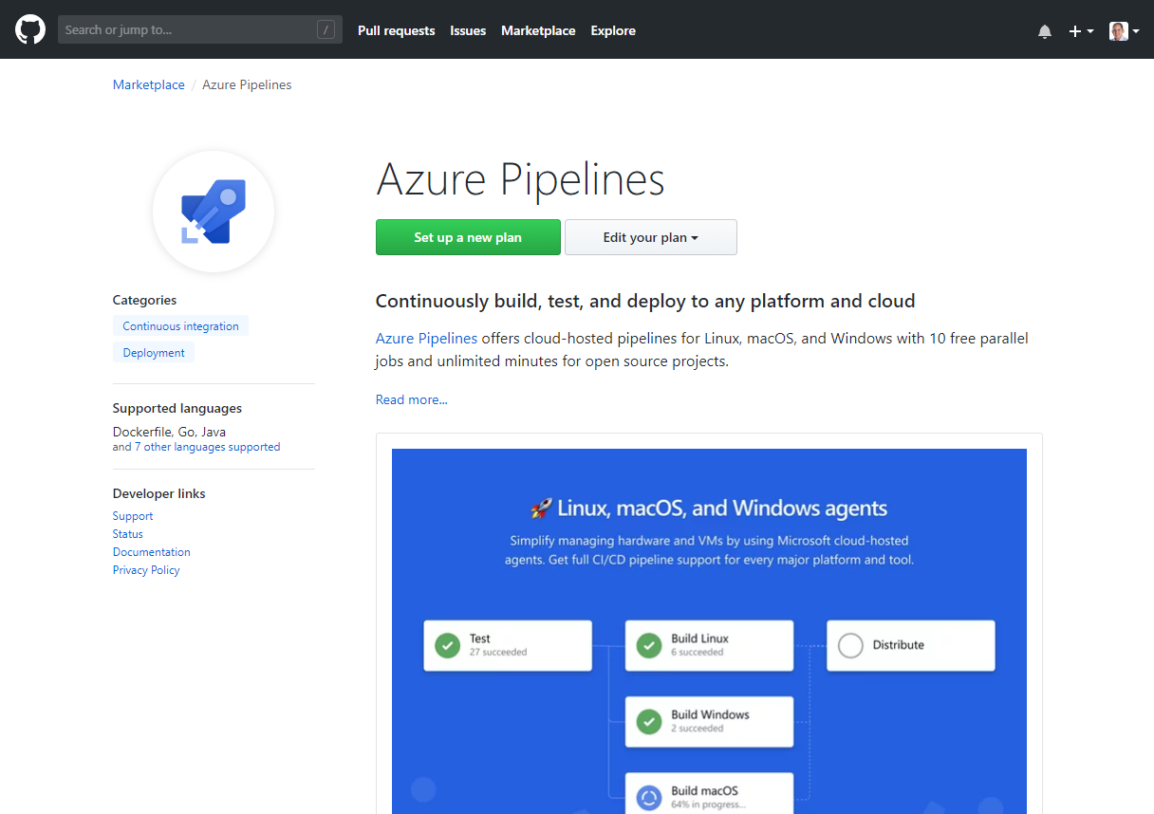
Integrated with GitHub
Azure Pipelines available now to any developer from the GitHub Marketplace

Slide 20
Open Source Powered by Azure Pipelines

Slide 21


Self-Hosted Agents
Ideal if you require custom build pre-requisites, control vendor license keys etc
Can create in cloud or on-prem
Can also deploy to on-prem servers from Azure DevOps
Can use deployment groups to dynamically provision to target deployment group types
Default
Hosted
Microsoft Hosted Agents
Self-Hosted Agents
Target on-premises environment
© Microsoft Corporation

Slide 22

DevOps for Desktop
DevOps principles are not just for web apps, containers & micro-service architectures. Common area of focus is on improving the flow of value to your customers with CI & CD to the desktop
Evergreen Installation Technologies
ClickOnce
Squirrel
Microsoft Store for Business and Education
Notes:
Private store in Microsoft Store for Business and Education.
Only Windows 10
Can work with WinForms / WPF apps using Desktop Bridge
Can use in combination with inTune for managed devices.

Slide 23

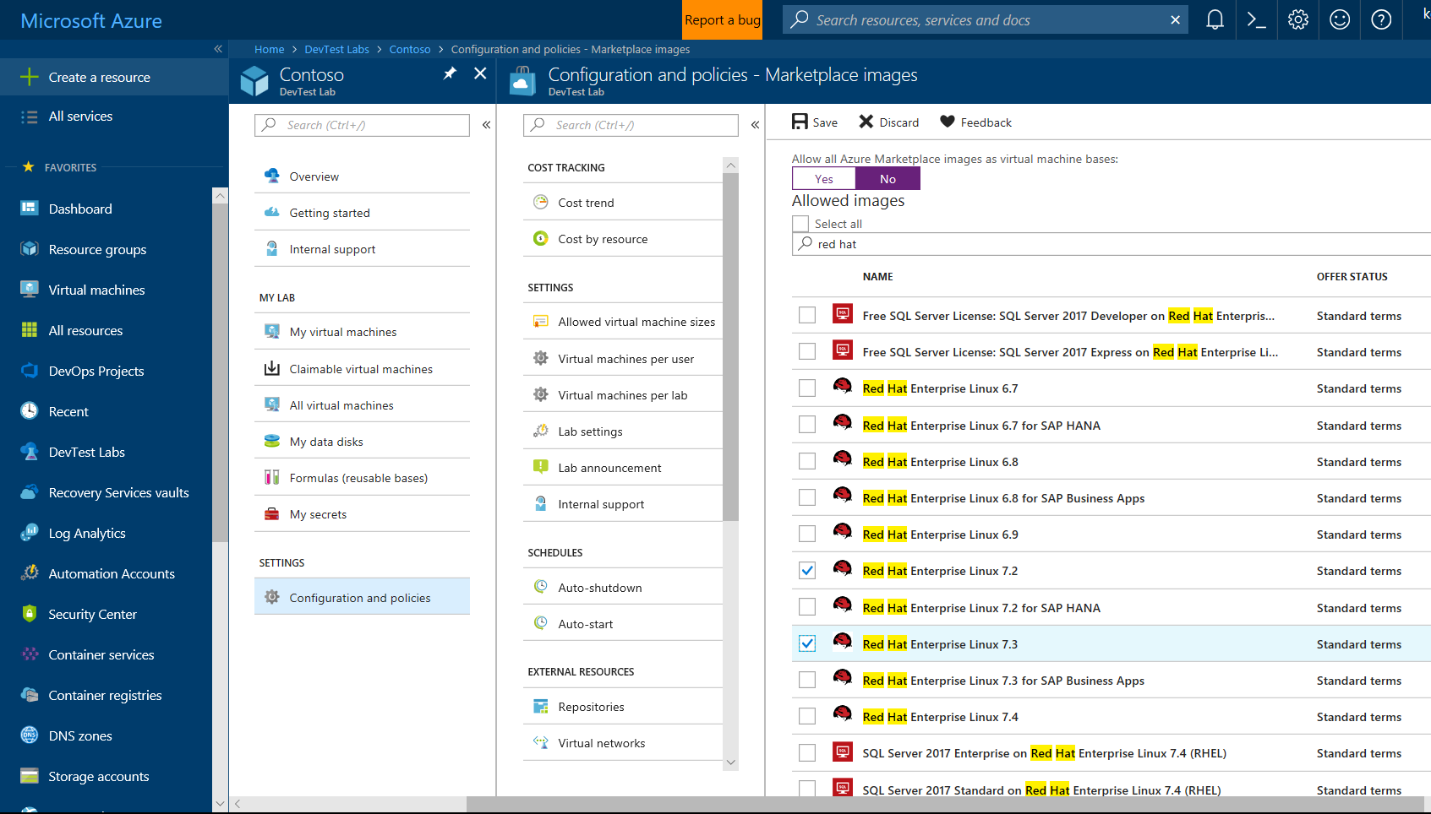
Self-Service Dev/Test Environments
Azure Lab Services
Simplify cloud environment management for developers and testers.
Enforce policies and control costs with full visibility
Use templates, custom images and formulas to reproduce environments.
Orchestrate with Azure Pipelines or integrate using REST API
Notes:
Whether you’ve already started implementing DevOps or looking to get started, a common challenge is for IT organizations is keeping up with project demand for development and test environments
DevTest Labs simplifies environment management for Dev & Test environments in the Azure cloud
Provide self-service access for teams, with policies to control cost and enforce use of appropriate images and artifacts

Slide 24

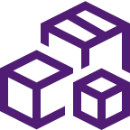



Azure DevOps
Plan smarter, collaborate better, and ship faster with a set of modern dev services
Any developer, any platform, any cloud. Full support for hybrid cloud, on-premises & containers.
Use all the Azure DevOps services or choose just what you need to complement your existing workflows
Best in class builds for open source. Free unlimited build minutes for public projects and up to 10 free concurrent jobs across Windows, Linux and macOS
Get started for free for small teams, scales to support the largest enterprises
Azure Boards
Azure Repos
Azure Pipelines
Azure Test Plans
Azure Artifacts
Start free today
➔
https://azure.com/devops

Slide 25
rcappello
@rcappello
Riccardo Cappello

Slide 26
Changes for existing VSTS / TFS customers
The same functionality you know and love today, with greater openness, flexibility and focus
Existing Accounts
Existing https://contoso.visualstudio.com URL continues to work. https://dev.azure.com/contoso available for opt-in.
New UI opt-in per user as preview feature. Will start advertising new UI once feedback from new accounts and early adopters has been incorporated.
Can disable services on a per project basis for new UI
New Azure branding in communications and documentation (emails, alerts etc).
Websites and documentation will move from Visual Studio to Azure based locations (with redirects in place).
Redirects available for some time.
TFS will remain the on-premises brand until the next major version in 2019. The new UI will be enabled in that release.
Existing TFS branded information and downloads remain in Visual Studio locations until next release.
Pricing
Public project usage is now free.
The free tier for Pipelines now includes 1,800 minutes per month, up from 240.
Pipelines can be used independently from Repos — so if you are only using Pipelines and your repos are hosted on GitHub you don’t need to pay for Repos or Boards (Basic) users.
New Accounts
https://dev.azure.com/contoso based URL.
New navigation & branding by default.
Notes:
The functionality you know and love today remains and will continue to be actively expanded on at the same rapid cadence as you are used to. The services will get even more open and extensible with more choice to your workflows. You will be able to move to the new UI when it works for you and your team
Existing Accounts
https://myorg.visualstudio.com continues to work but new https://dev.azure.com/myOrg address also available for opt-in.
New UI opt-in per user. Will start advertising new UI once feedback from new accounts and early adopters has been incorporated.
Can disable services on a per project basis
New Azure branding in communications and documentation (emails, alerts etc).
Websites and documentation will move from Visual Studio to Azure based locations (with redirects in place).
Redirects available for some time.
TFS will remain the on-premises brand until we ship the next major version in 2019. Existing TFS branded information and downloads remain in Visual Studio locations until next release. The new UI will be available in that release.
Pricing
A few key changes:
Public project usage is free.
The free tier for Pipelines now includes 1,800 minutes per month, up from 240.
Pipelines can be used independently from Repos—so if your repos are hosted on GitHub you don’t need to pay for Repos & Boards (Basic) for your users.
New Accounts
https://dev.azure.com/myOrg based URL.
New UI by default.

Slide 27
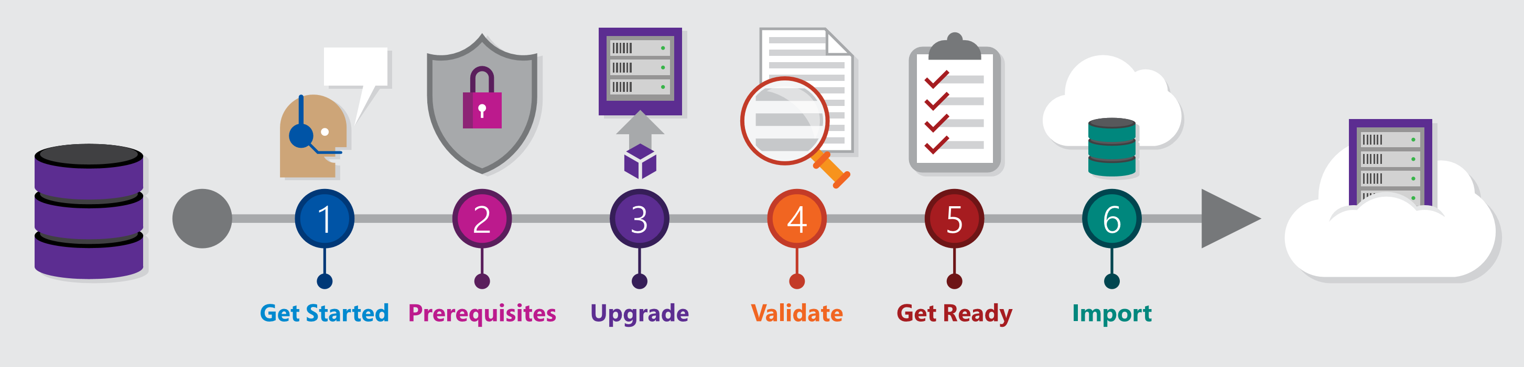
Migrating from TFS to Azure DevOps
Move from Team Foundation Server to Azure DevOps and bring your data along
Benefits of Cloud Hosted Azure DevOps Services
Global availability
Hosted and maintained by Microsoft with 99.9% uptime guarantee and 24x7 support
Immediate access to latest features
Simplified deployment to Azure
TFS Import Service
Fully supported high fidelity migration path
Trusted by many large enterprises
Now faster and easier to use
➔
https://aka.ms/tfsimport

Slide 28
Azure DevOps Services Pricing
Open Source Projects
Small Teams
Teams of any size
Free
Unlimited users and build time
Azure Pipelines: 10 parallel jobs with unlimited minutes for CI/CD
Azure Boards: Work item tracking and Kanban boards
Azure Repos: Unlimited public Git repos
Free
Start free with up to 5 users
Azure Pipelines: Run 1 Microsoft-hosted job for 1,800 minutes per month and 1 self-hosted job for any amount of time
Azure Boards: Work item tracking and Kanban boards
Azure Repos: Unlimited public Git repos
Azure Artifacts: package management
Unlimited stakeholders
Starts at $6 per user, per month for Boards & Repos*
Easy pricing that grows with your team
Azure Pipelines: Run 1 Microsoft-hosted job for 1,800 minutes per month and 1 self-hosted job for any amount of time
Azure Boards: Work item tracking and Kanban boards
Azure Repos: Unlimited public Git repos
Azure Artifacts: package management
Unlimited stakeholders
Boards & Repos included for Visual Studio subscribers
*
https://azure.com/pricing/details/devops/
5 Boards & Repos users and 5 Artifacts users free. Pipelines with unlimited minutes, Test Plans users and additional Artifacts users also available. Please see the Azure pricing calculator for details.
➔

Slide 29
rcappello
@rcappello
Linkedin.com/in/rcappello

